Slide 1
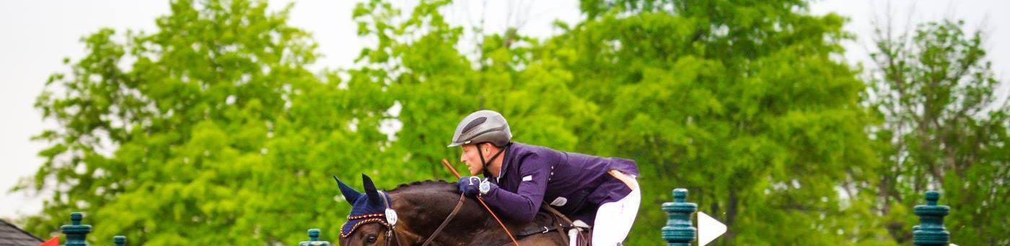




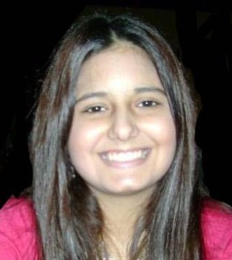
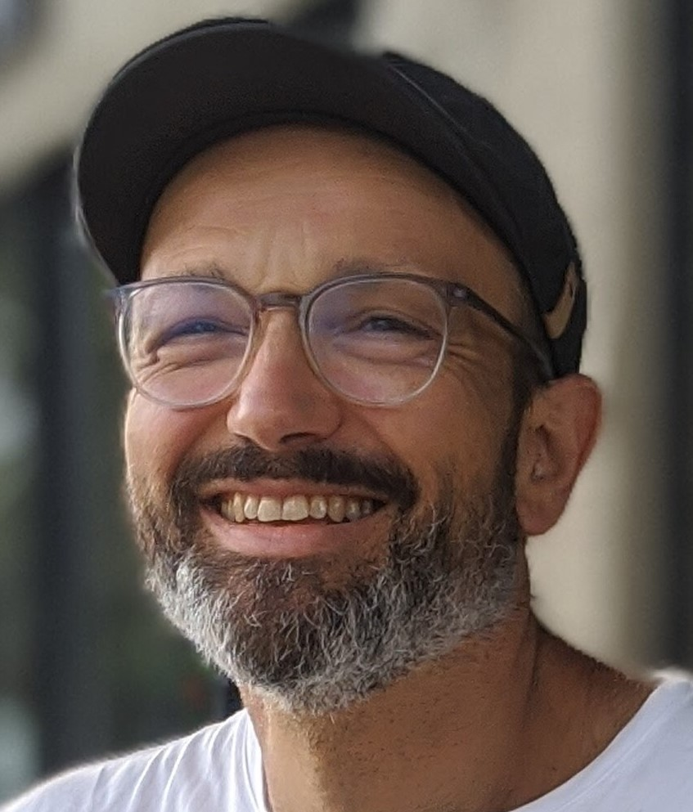
HORSEPOWERED MACHINE LEARNING Safer Eventing Through Machine Learning & Data Analysis
UNC DATA ANALYTICS BOOT CAMP - FINAL PROJECT
HEATHER
ALLARDICE
JOCELYN
CONARD
NATE
KELLY
MEGAN
CROSS
ELIZABETH
PASI
ALESSANDRO
TRAVAGLIA

Slide 2
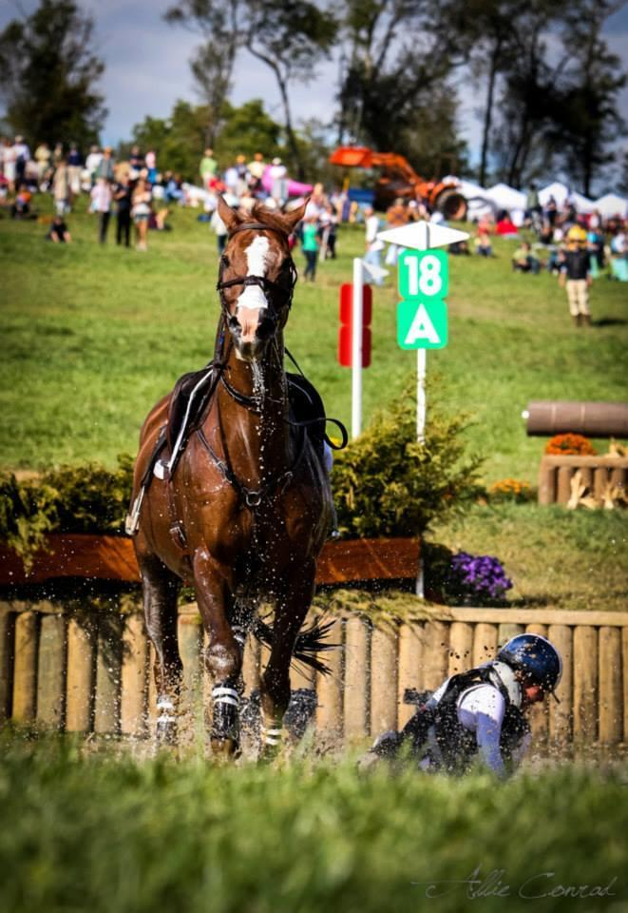
PROJECT OUTLINE
Background
During eventing equestrian competitions, horse falls are rare yet serious parts of the sport
ER records report serious injuries associated to horse falls
Project Goal
Develop a model using ML to predict conditions that may increase risk of fall
Use real data from USEA recognized event results
Data set will be expanded in the future through surveys currently being implemented by project team
Challenges
Data are sparse and messy – response rate is very small
Predicting rare events is difficult

Slide 3
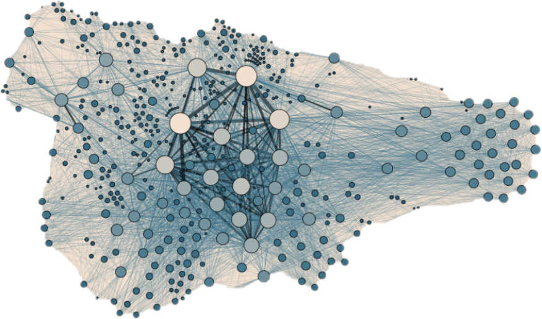
CODING OVERVIEW
Obtain real data from
equestrian triathlons
Poor or mixed encoding
Transpositions and errors
Missing data
Data wrangling/cleaning
Python, Pandas, FuzzyWuzzy
Replace missing data
Bayesian model
Forecast horse falls
Deep learning sequential model
Predict falls based on multiple variables

Slide 4
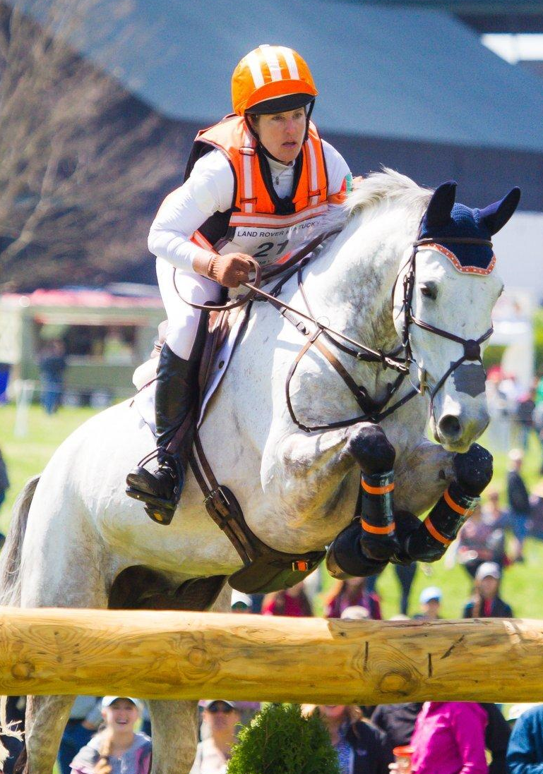
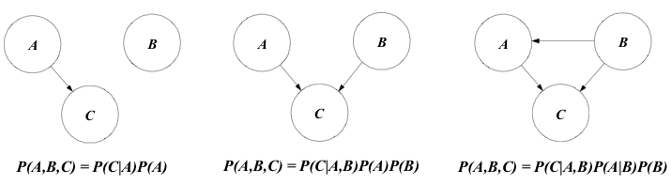
Bayesian Modeling Framework
Statistical Analysis Considerations
Dropping data points is not advantageous when the event is rare
Bayesian model predict the accuracy of a data point in percentages.
Subbing in mean or median for missing data does not capture relationships between data points
Solution
Adopt a Bayesian modeling framework to develop missing data in the original dataset. We achieved 86% accuracy.
Advantages

Slide 5
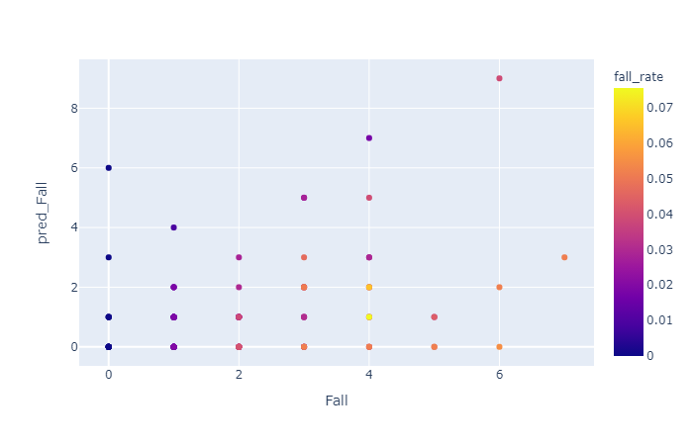
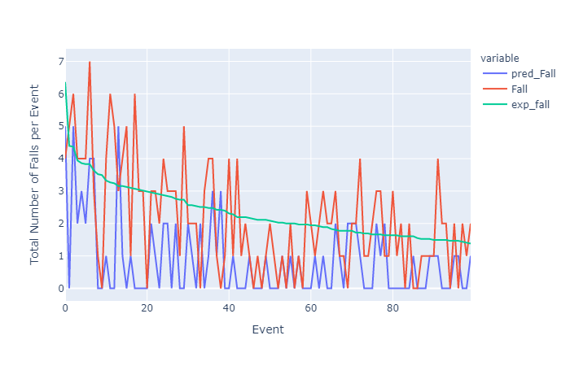
Machine Learning Deep Learning Sequential Model
Features:
•Over 55k rows of data
•Rider, Horse, Event, Difficulty, Senior, Jr, Combined Test, Dressage Score, and Place
•To be added: Weather, Location (from API data)
•Wind Speed, Visibility, and Precipitation were found to be significantly associated with Falls
•Mix of categorical and scalar data
•Tensorflow Keras Sequential model
Model Metrics:
•Model was tuned with Keras Tuner
•Accuracy: 0.9629
•F_score: 0.048
•True Negative:13324
•True Positive:343
•False Negative:10
•False Positive:136

Slide 6
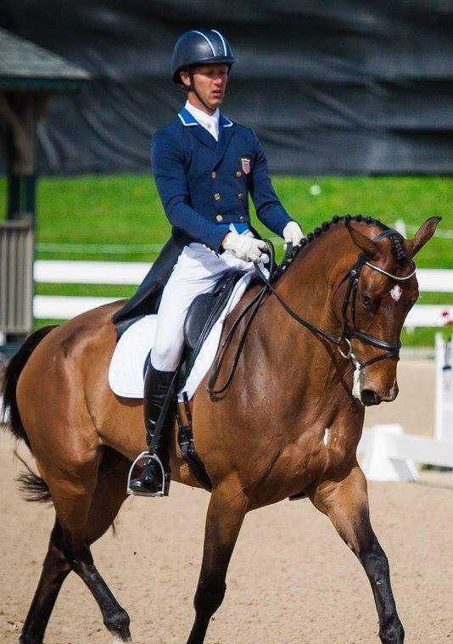
Conclusions and Next Steps
Conclusions &
Next Steps
Developed online survey for active riders
Continue expanding data set with survey results
Refine modeling to increase awareness and improve safety
https://us-eventing.herokuapp.com/

